Slide 1
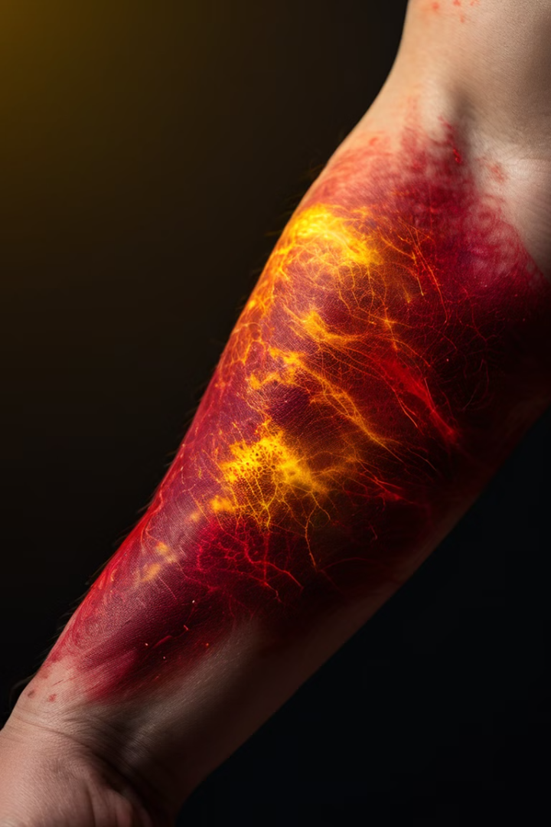
Medical Image Gen
Generating Skin Rashes Images from Textual Prompts
This presentation will explore a novel approach to generating realistic medical images of common skin rashes based on textual descriptions. By leveraging advanced AI techniques, we aim to create a powerful tool for medical education, diagnosis, and research.

Slide 2
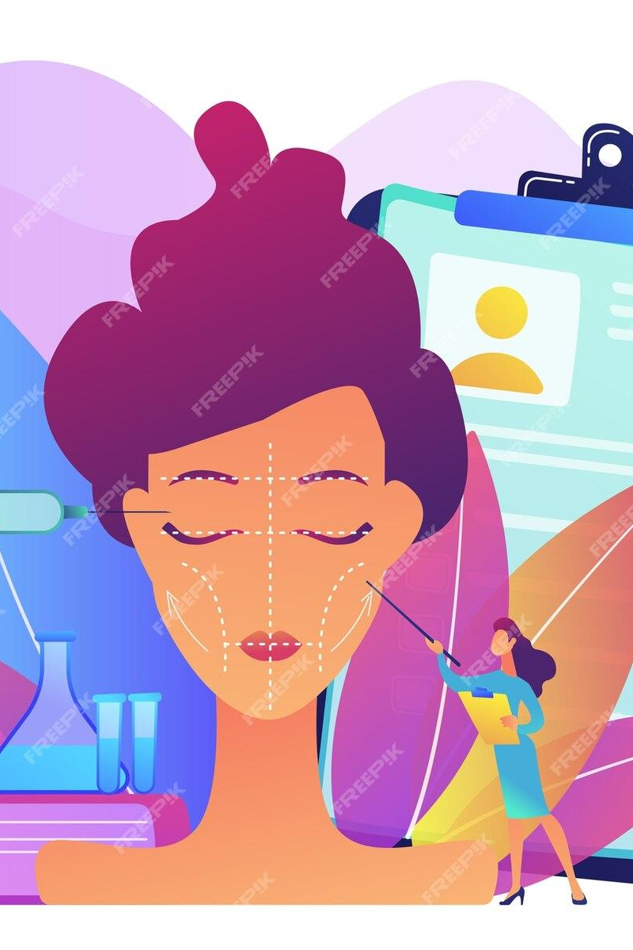
Problem Statement & Significance
1
Easier Understanding without assistance
2
Enhance Medical Education and Training
Provide a valuable resource for medical students, practitioners, and researchers to learn about and analyze various skin conditions.
Enable remote diagnosis and monitoring of skin conditions, improving access to healthcare.
3
Support Diagnosis and Research
The generated images can help in developing and testing algorithms for automated skin rash detection and diagnosis, as well as furthering medical research.

Slide 3
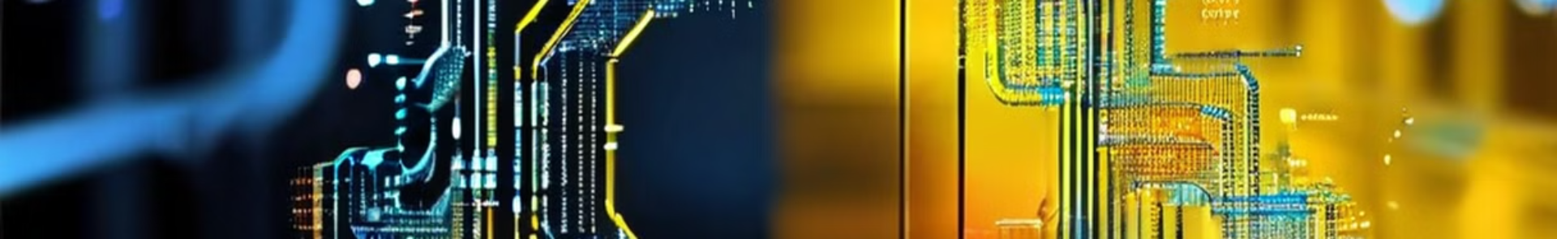
Technical Approach
Data Collection
Image Generation
Collected data from skin disease dataset from kaggle(https://www.kaggle.com/datasets/ismailpromus/skin-diseases-image-dataset)
with 2000 images in each rash type and also scraped data from dermnet site('https://dermnetnz.org)
Use the pretrained model to generate realistic skin rash images based on new textual prompts, controlling for rash type, skin color, and affected area.
1
2
3
Model Training
Fine Tuned the clip component while training it with skin images and used a pretrained model to generate images

Slide 4
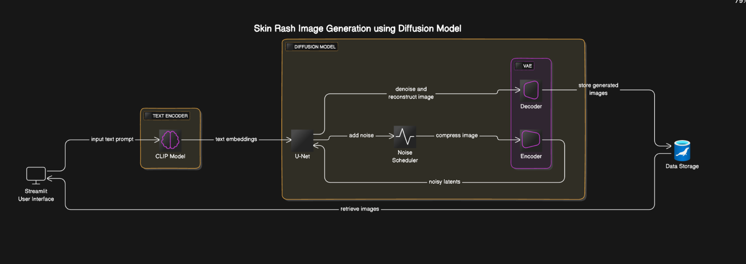
System Architecture
Text Prompt
Generative Model
Output Image
Users input a textual description of the desired skin rash, including the type, skin color, and affected area.
A conditional GAN (cGAN) model processes the textual prompt and generates a photorealistic image of the corresponding skin rash.
The generated skin rash image is displayed to the user, providing a visual representation of the described condition.

Slide 5

Implementation and Libraries Used
Data Collection
Beautifulsoup - Scarping
selenium
Frontend/ UI
Streamlit
localtunnel
Model Training
transformers
torch
PIL
diffusers
Platform
Google Collab
T4 GPU

Slide 6
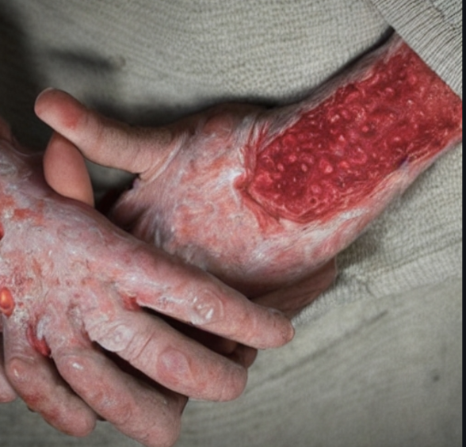
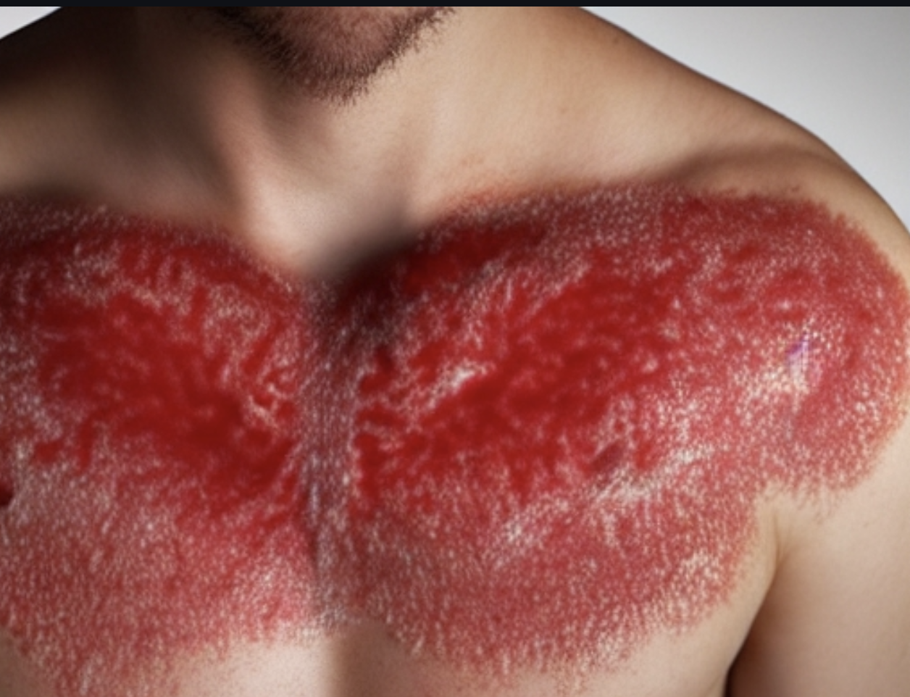
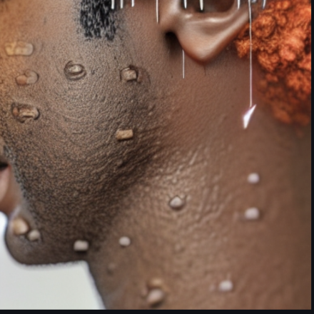
Results and Evaluation
Eczema on Fair Skin
Ringworm on chest with fair skin
Dermatitis on neck with brown skin

Slide 7

Analysis & Conclusions
1
Accurate Representation
2
Diverse Skin Tones
The system demonstrates the ability to generate realistic skin rashes across a wide range of skin tones, addressing the need for inclusive medical imagery.
With proper description in prompt, the images are generated more accurately
3
Inference steps
the generated images vary with inference steps. At times with less number of steps the image generated is more accurate than with more steps.

Slide 8




Future Directions and Limitations
Expand Dataset
Collect a larger and more diverse dataset of skin rash images and textual descriptions to further improve the model's performance and generalization.
Incorporate Interactive Features
Develop an interactive interface that allows users to fine-tune the generated images by adjusting the textual prompts or providing additional input.
Explore Medical Applications
Investigate the use of the generated images in medical diagnosis, treatment planning, and educational resources for healthcare professionals.

